Slide 1
The Five Messages Leaders Must Manage by John Hamm

Slide 2
Harvard Business Review on Communication

Slide 3

LO1: How leaders talk?
IF YOU WANT TO KNOW
Why so many organizations sink into chaos, look no further than their leaders’ mouths.
Unclear statement of leaders
Self defined meaning by top managers
Corporate objectives derailed
“Let’s focus on the key priorities” “Customers come first,”

Slide 4
Continue
Over and over again, they present grand, overarching—yet fuzzy—notions of where they think the company is going. CEO uses inflated terms like vision, loyalty, accountability, customer relationships, teamwork, focus, priority, culture, decision making, results, and so on, virtually ad infinitum.
Leadership, at any level, certainly isn’t easy—but unclear, vague, roller-coaster pronouncements make many top managers’ jobs infinitely more difficult than they need to be.

Slide 5
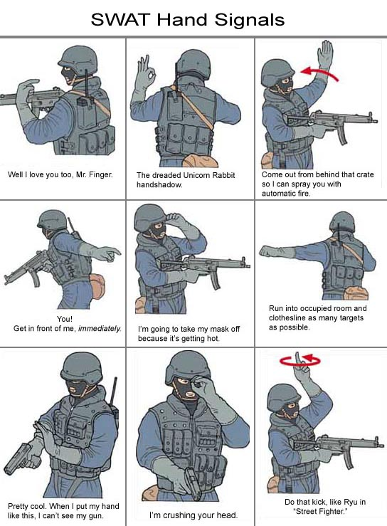

LO1: How leaders talk?

Slide 6
LO2: The five messages for a leader
Five topics extraordinary influence within a company:
Organizational structure and hierarchy
Financial results
The leader’s sense of his or her job
Time management, and
Corporate culture.

Slide 7
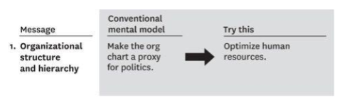
LO2: a: Organizational structure & hierarchy
When your company reorganizes, quickly frame the change as a way to optimize your company’s resources—not to oust or devalue employees.

Slide 8
Continue…….
When your company reorganizes, quickly frame the change as a way to optimize your company’s resources—not to oust or devalue employees.
Example: The CEO of a small software company had to realign internal resources when a close rival began gaining an advantage. He called an all-hands meeting, explaining, “We’re in a war for market share. I don’t think we’re properly configured to win the battle, so I’m restructuring resources so we can execute more effectively. Most of you will continue doing the same jobs, but you may have a different supervisor.” He showed them the new organization chart, then asked them to begin working in their new positions after lunch.

Slide 9
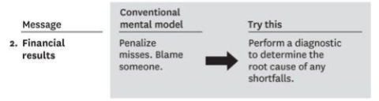
LO2: b: Financial results
Discuss disappointing results not as evidence of punishable failure but as useful diagnostic and learning tools that enable constant improvement.

Slide 10
Continue
Discuss disappointing results not as evidence of punishable failure but as useful diagnostic and learning tools that enable constant improvement.
Example: When a technology firm missed a quarterly goal, the CEO asked his team rigorous questions about what caused the shortfall, rather than placing blame. Instead of worrying about who would take the heat, team members uncovered the problem’s root cause and identified ways to prevent a recurrence. From then on, the company’s track record for quality was the envy of the industry.

Slide 11
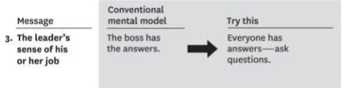
LO2: c: The leader’s sense of his or her job
Let followers know that your job is not to provide all the answers but to invite their ideas.

Slide 12
Continue
Example:
When one CEO met with functional leaders to discuss the
company’s failure to increase market share, he listened to
their viewpoints, posed questions, and challenged opinions
rather than stating his own theory. He then assigned a task
force to address the problem. The team generated numerous
recovery plans, the most compelling of which was
implemented. The plan produced the desired market-share
gains in the next three quarters.

Slide 13
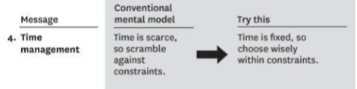
LO2: d: Time management
Communicate the importance of using time strategically, rather than trying to get more things done faster.
Ask where you can best focus your team’s energy.
By understanding that you have a choice about how limited time can be used, you can free up needed resources to focus on your most important goals.

Slide 14
Communicate the importance of using time strategically, rather than trying to get more things done faster. Ask where you can best focus your team’s energy. By understanding that you have a choice about how limited time can be used, you can free up needed resources to focus on your most important goals.

Slide 15
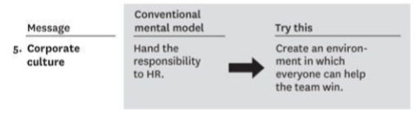
LO2: e: Corporate culture
Create a healthy culture by articulating the right goals and defining criteria for success.

Slide 16
Continue
Create a healthy culture by articulating the right goals
and defining criteria of success.
Example: The CEO of a telephony-software company runs his
firm like a high performing sports team. He displays metrics—
sales, expenses, revenues—on a scoreboard for all to see. And
he clearly defines what success looks like: “P/E ratio of15,
market share of 20%, 30% year-over-year revenue
growth.”
Large goals—“$20million by the third quarter”—are
broken into strategic parts marked on the scoreboard.

Slide 17


